Slide 1

WHAT THE **** IS A DATA PRODUCT?

Slide 2



Johnny winter (HE/HIM)
Notes:
I’m Johnny Winter – my pronouns are he him.
For those that don’t know me…
I work as a consultant for Advancing Analytics – we’re Data Engineering, Analytics and AI specialists
In my spare time I run the website Greyskull Analytics where I have a blog and YouTube channel, mainly covering content on Power BI
And I’m also one of the co-organisers of the Manchester Power BI user group, one of the biggest and longest running user groups in the UK

Slide 3






Notes:
I’ve been working in data since 2007 and here are some of the places that career has taken me.
My last 3 roles have all been consultancy jobs

Slide 4

Tell me about you…

Slide 5

agenda
Where did the term come from?
What does it mean?
Is it a good idea?

Slide 6

WHERE DOES THE TERM DATA PRODUCT COME FROM?

Slide 7
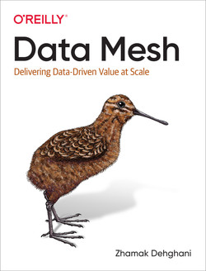

The RISE OF DATA PRODUCTS
Notes:
Published in 2022

Slide 8
The FIRST RULE OF DATA MESH…
Data Mesh is NOT an architecture…
Data Mesh is a decentralised sociotechnical approach to data management

Slide 9




THE 4 PRINCIPLES OF DATA MESH
Principle of Domain Ownership
Principle of Data as a Product
Principle of the Self-Serve Data Platform
Principle of Federated Computational Governance

Slide 10





What is data mesh
Product
Supply Chain
Central IT
Marketing
Finance
Sales
Notes:
Traditionally, Central IT would ingest, process and serve all of the data. Each department or business unit would consume from this central function
That doesn’t scale well. It keeps responsibility for the data in the hands of central IT

Slide 11
What is data mesh
Supply Chain
Product
Central IT
Marketing
Finance
Sales
Notes:
Traditionally, Central IT would ingest, process and serve all of the data. Each department or business unit would consume from this central function
That doesn’t scale well. It keeps responsibility for the data in the hands of central IT

Slide 12
What is data mesh
Data Product
Domain
Domain
Domain
Domain
Domain
Notes:
Domains – business unit aligned or teams or departments or analytical alignment
Data as a product – domains producing data outputs as products for end users and other domains to interact with. Is this a data model?
Governance – this creates federated governance within each domain. They own their data, the processes to prepare it and the security surrounding it

Slide 13
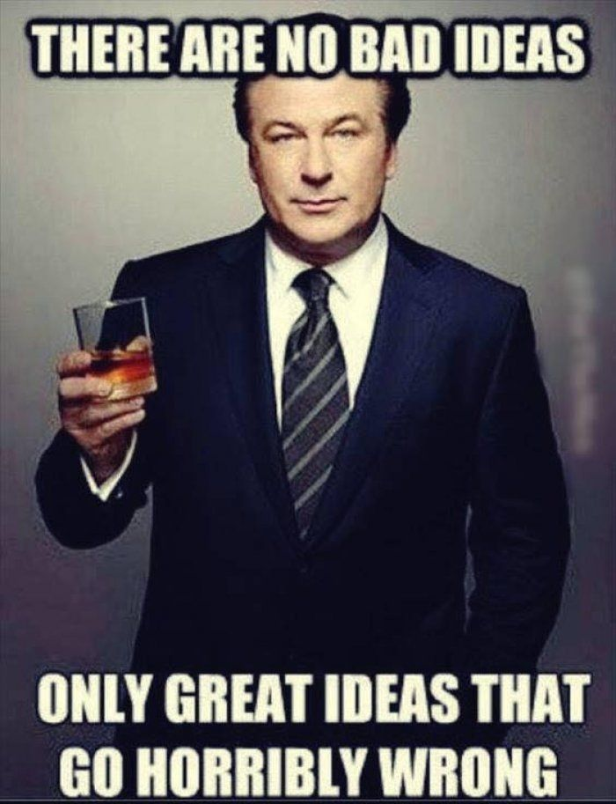
IS THIS A GOOD IDEA?

Slide 14

IS THIS A GOOD IDEA?
THERE ARE NO BAD IDEAS
ONLY GREAT IDEAS THAT GO HORRIBLY WRONG

Slide 15
DATA AS A PRODUCT
Data as a Product prevents data siloing
Provides a set of explicitly defined data sharing “contracts”
Data becomes something that domains share as opposed to collect

Slide 16
ARE DATA PRODUCTS A NEW THING?
“Data as a product principle defines a new concept, called data product, that embodies standardised characteristics to make data valuable and usable.”

Slide 17
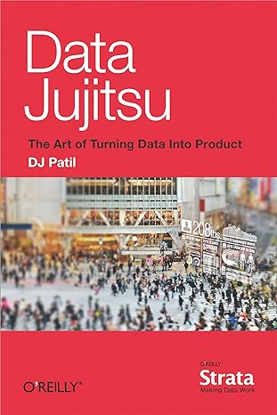

MAYBE NOT…
Notes:
Former United States Chief Data Scientist
Booked published in 2012

Slide 18
MAYBE NOT…
“A product that facilitates an end goal through the use of data”
Notes:
Former United States Chief Data Scientist

Slide 19
Oh THE AMBIGUITY…
“The term data in this book, if not qualified, refers to analytical data. Analytical data serves reporting and machine learning use cases.”

Slide 20


DATA PRODUCTS
ANALYTICAL DATA PRODUCTS

Slide 21

WHAT DOES THE TERM ANALYTICAL DATA PRODUCT MEAN?

Slide 22
WHAT IS AN ANALYTICAL DATA PRODUCT?
A way of thinking about your data
Provides a set of explicitly defined data sharing “contracts”
A specific set of characteristics

Slide 23
APPLICATION OF product THINKING
Valuable
Something people choose to use
Usable
Easy to figure out how to use
Feasible
Buildable using the technology stack and skills available
Viable
Workable for our stakeholders within our budget, legal, ethical, and reputational constraints
Product

Slide 24

Defining Analytical Data Products
A domain-bound set of data services, including the underlying infrastructure & code to produce/maintain
Essentially – one or more tables that can easily be queried, providing curated, trusted insight into a specific area of business
It Is:
A Data Model
A Reporting Table
It is NOT:
A Dashboard
An Application
An Entire Data Warehouse / Lake
An ML Model

Slide 25

DEFINING ANALYTICAL DATA PRODUCTS
Discoverable
Addressable
Understandable
Trustworthy and truthful
Natively accessible
Interoperable and composable
Value on its own
Secure
Notes:
Discoverable – i.e. people know it exists – think Data Catalogs etc…
Addressable – offers permanent and unique address… stays in the same place, doesn’t get superceded by something different
Understandable – plays into the usability element. Should be intuitive but also have accompanying documentation (formalised description of the data… think data dictionaries)
Trustworthy – data quality metrics but also timelineness and completeness plus performance
Natively Accessible – can be accessed by a range of users using their preferred tooling. SQL/Excel/Power BI
Interoperable – common metadata fields, common primary/surrogate keys
Value on it’s own – a single fact table with no context is no good… should have wider context/value
Secure - duh

Slide 26


Slide 27

Is it a good idea?

Slide 28
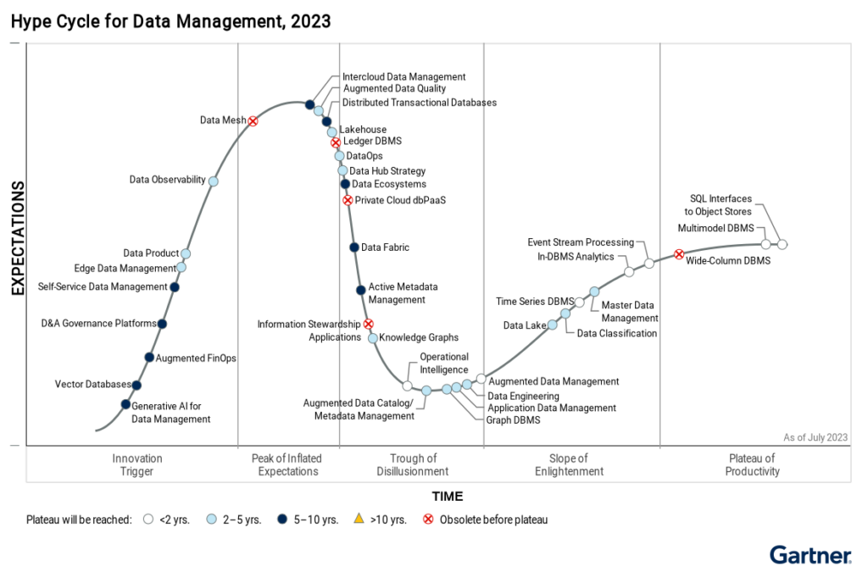
Data Mesh is dead
Notes:
Sounds like nirvana right? Im picturing a scene from Star Trek, no one needs money anymore. Everyone is happy
Well, According to Gartner, Data Mesh is already obsolete before its reached peak hype.

Slide 29
Data Mesh is dead
Notes:
And they’re not wrong in my opinion. To achieve a true data mesh, you are expecting a level of distributed skills, robust processes, and second nature discipline that doesn’t exist in startups let alone large enterprise organisations struggling to move away from Excel-based databases. It’s the people and process that lets it down. Not the tech
Its not all doom and gloom though and we can salvage some pieces

Slide 30
LONG LIVE DATA PRODUCTS
Notes:
Sounds like nirvana right? Im picturing a scene from Star Trek, no one needs money anymore. Everyone is happy
Well, According to Gartner, Data Mesh is already obsolete before its reached peak hype.

Slide 31
APPLICATION OF product THINKING
Valuable
Something people choose to use
Usable
Easy to figure out how to use
Feasible
Buildable using the technology stack and skills available
Viable
Workable for our stakeholders within our budget, legal, ethical, and reputational constraints
Product

Slide 32

QUESTIONS?

Slide 33
THANK YOU!
Twitter:
@GreyskullPBI
LinkedIn: https://www.linkedin.com/in/j0hnnyw1nter/
Websites:
https://greyskullanalytics.com/
https://www.advancinganalytics.co.uk/

